Slide 1

Safety Moment

Slide 2
Safety Moment Mobile Phones
Safety is paramount at National Grid, Our vision is “Zero Injuries Every Day.” Don’t look away – we have a collective responsibility to address any unsafe acts we may see.
Also, it’s our individual responsibility to our families and loved ones to keep ourselves safe. It makes sense – by keeping ourselves injury free we can all go home in good shape and enjoy our lives outside work.
We would like to share this safety moment with you.
http://www.youtube.com/watch?v=Tlxjng8h3Tc

Slide 3
Safety Message Mobile Phones
From 1st December 2003, it is an offence to use a mobile phone or similar device while driving, if the device has to be held in doing so; this includes the cradling of the device between shoulder and ear. Amendments to this legislation, enforced in 2005, mean that a convicted offence will attract a fixed penalty and a 3-point license endorsement.
Switch mobile phones off leaving a safety message on your answer phone
Hand free devices can also cause distraction when driving
NGG are moving away from hands free usage

Slide 4

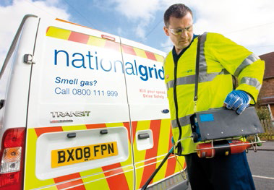
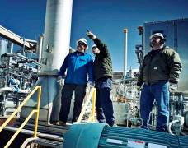


Welcome
8th October 2014
Hilary Buxton – Head of Process

Slide 5
Agenda
10.00 Welcome and introductions, including background of National Grid Gas Distribution
10.20 Presentation - Distribution Network Control Centre
10.40 Group 1a and 1b Bio Gas Overview
Group 1c Working together – moving forward
Group 2 Tour of Distribution Network Control Centre/Coffee
11.20 Group 1 Tour of Distribution Network Control Centre/Coffee
Group 2 Presentation Bio-Gas Overview
12.00 Presentation from Network Strategy
12.30 Lunch
1.10 Presentation – Firm Load Shedding
1.30 Presentation - Customer Centre
1.50 Enquires and complaints/Listening to emergency calls
2.50 Coffee
3.05 Presentation and demonstration - Resource Management and Dispatch
3.45 Wrap up
4.00 Close

Slide 6
Introduction to National Grid Gas Distribution

Slide 7
Where energy comes from
http://www.nationalgrid.com/NR/rdonlyres/194E85A8-7D7E-4754-9F7C-3B51BE8424D7/43864/NationalGrid_351.wmv

Slide 8
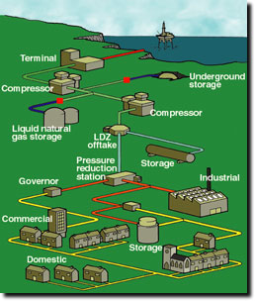
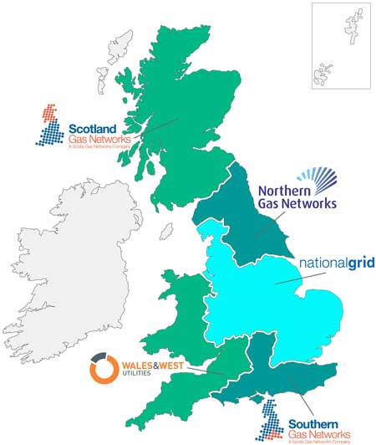
How gas is moved within the UK
Notes:
Gas is delivered to nine reception points, or terminals, by gas producers.
For decades, gas has been delivered to homes and businesses throughout Great Britain. It has become the country's most dependable form of energy.
During recent years the gas supply industry has virtually reinvented itself. Thanks to the dependability of supply, these changes have largely gone unnoticed.
They have resulted in the introduction of a 'level playing field' for all participants in the gas supply industry and the introduction of competition in domestic gas supply.
As Transco, our company played a vital, central role in the development of the modern gas industry. As National Grid, we continue to provide high quality systems and services, transporting gas in the safest, most secure and reliable way.
There are now 8 separate gas networks owned by 4 companies – NGG (4), SGN (2), NGN (1), WWU (1)

Slide 9
Gas distribution – how we are structured
Gas Distribution
Emergency
Response &
Repair
Replace and
Extend
Network Strategy
Operations
Gas Distribution Strategic Partnerships
Customer Operations
Stakeholder Delivery
UK RIIO Delivery
Operate and
Maintain
UK Business Change
SSR – UK Regulation – Finance & Shared Services – IS – Legal – HR – Corporate Affairs

Slide 10
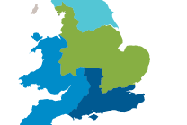

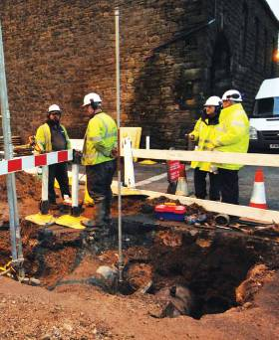
Scale of our operations
131,000 kilometres of pipelines
26 active gas shippers
10.8 million consumers
operate 24 hours a day, 7 days a week
£400 million running the gas emergency service
Reducing risk of iron mains over 8yr RIIO
maintain gas distribution above ground assets
replace complex gas mains
Annual increases in customer satisfaction
over 3 million calls per year
meter number enquiry service
appliance repair helpline
enquiries line
national gas emergency number (0800 111 999)
Reliability levels of 99.99%
533,000 emergency jobs
616,000 metering jobs
70,000 repair jobs (7000 caused by 3rd parties)
24,000 connections jobs
c5,000 fuel poor homes connected to gas p.a.
10
45 live biomethane connection projects

Slide 11
Working with our stakeholders

Slide 12
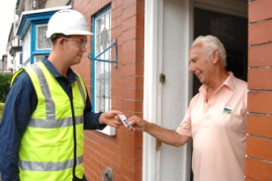
Our five key priorities
We will keep you safe and warm
We will be reliable
We will safeguard future generations
We will deliver a quality service to all
We will provide value for money
Notes:
We have a very broad range of stakeholders from domestic customers, gas shippers and suppliers, to fuel poverty groups, biomethane produces, electricity distribution networks, Local Authorities, Highways Authorities – some of you are in this room today
To establish our 5 priorities we engaged over a 2 year period to understand what was important to our stakeholders and we now have an 8 year contract known as RIIO to deliver the things that are important.

Slide 13

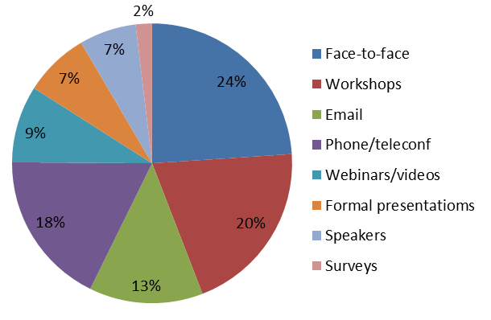
Our recent engagement results
To understand how we are doing, how we can improve and understand what our
stakeholder priorities should be for 2014/15
We received over 70 stakeholder responses - our results were very similar to last years’
How are we doing?
Was it a worthwhile use of time engaging with us?
Felt listened to and had a chance to have their say?
Did we act on feedback, or if not advised why not?
How would you rate the ‘Talking Networks’ web site?
How do you want to engage?
How useful were the fact sheets and pre-reading material
Treated fairly during the engagement?
Yes
92%
Preference for
personal engagement
No
8%
Yes
100%
No
0%
Yes
76%
No, but
explained why
15%
Useful/
helpful
83%
Too early
to say
9%
No /
not used
17%
Good to
Excellent
100%
Yes
97 %
No
3%
3
Notes:
Although we have an eight year plan we recognise that our stakeholders priorities change over time. So we consult every year, starting in December and consult for three months.
We ask how you think we are doing and how we can improve, whether you want to continue engaging with us and what are you priorities for the next 12 months.
This year we had over 70 responses. We had some really positive responses that we can build upon. We also know that we have to improve our relationships in some areas – and Local Authorities is one area we need to work on.

Slide 14
Our stakeholders’ feedback
What stakeholders have been telling us
“Influencing the industry and involvement in industry groups including increased openness and transparency”
“Better coordination, planning and communication…”
“Improve image, planning and reputation around streetworks & working more collaboratively with LAs”
“Image and reputation fulfilling a vital role…”
“Raising profile… for how to keep customers safe”
“Carbon Monoxide safety and awareness…”
“Awareness of what NG/the industry does”
“Safe and efficient network”
“Shorter duration for repairing gas escapes and effective planning”
“Helping others less fortunate e.g. fuel poverty and vulnerability”
Our RIIO priority *
Our RIIO priority*
We will deliver quality service to all
We will keep you safe, warm and be reliable
“
“Overhaul and completed modernisation of the bio-methane process”
“Product innovation”
”Promoting new ways of working”
“Innovation and promoting… renewable gas into the network”
“Focus on environment and sustainability”
“Make processes smoother for small companies”
“Providing the industry and its customer with value for money”
“Transparency of costs, how money is spent and how we are delivering on our RIIO targets”
“Paying suppliers in a timely manner and enabling small companies to participate e.g. innovation”
Our RIIO priority*
Our RIIO priority*
We will safeguard future generations
We will provide value for money
4
Notes:
This is a snapshot of some of the feedback we received and from this we have made 12 broad commitments

Slide 15
Our 12 new commitments – 2014/15
We will play our role in industry change, working collaboratively and across the industry whilst understanding the issues of others.
We will continue to improve and modernise the sustainable gas connections process.
1
7
We will be active in our communities keeping them informed of local plans, working collaboratively with others for optimum solutions and increasing awareness and visibility of what we do
We will focus on innovation facilitating new uses of gas sources
2
8
We will take an honest and open approach to develop effective working relationships listening to our stakeholders and acting on their feedback.
We will continue to articulate the story for gas, with a focus on the environment whilst providing long term value for money for consumers
3
9
We will work collaboratively to deliver cross industry solutions for those in fuel poverty / vulnerability.
We will provide transparency of costs and how money is spent as well as how we are delivering our RIIO targets.
4
10
We will work collaboratively to deliver cross industry solutions related to Carbon Monoxide and other safety related issues.
We will focus on our end-to-end processes bringing improvements and efficiencies.
5
11
We will work locally to deliver a safe reliable network, delivering innovation to minimise the impact of our works.
We will work across our supply chain, including smaller organisations, and identify areas for collaboration
6
12
Notes:
These are our 12 commitments – I won’t go them all individually as we have copies of the documents for you but please feel free to ask us questions as we go through the day.

Slide 16


Our new stakeholder commitments - 2014/15
Published April 2014
Based on feedback
Five key priorities – mapped to
key outcomes to be achieved
We will provide updates through
the year and report in November
Let us know your thoughts, we
want to hear from you at any time
www.talkingnetworksngd.com
Notes:
We published these commitments in April and we will publish an interim report next month letting you know how we are progressing with our 12 commitments. We will again consult in December and please feel free to register on our talking networks website if you want to get involved.
Before I hand over to Carole, who will lead you through the day, we’ve tried to make it interactive and to give you an opportunity to meet our people, see what they do and ask any questions.

Slide 17
Overview for the day

Slide 18
Overview for today
Today is an opportunity to meet our people. You will see:
how gas is transported around our distribution networks by our Distribution Network Control Centre;
how we model use of gas around our network by our Network Strategy team;
how our Customer Centre manages calls, enquiries and complaints; and
how we plan our resources and dispatch our field operatives to attend site

Slide 19
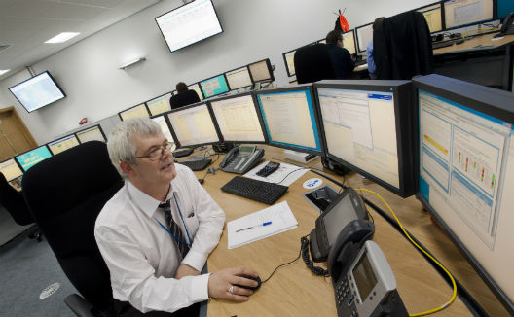
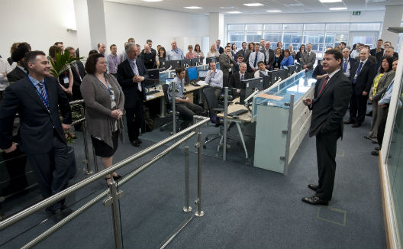
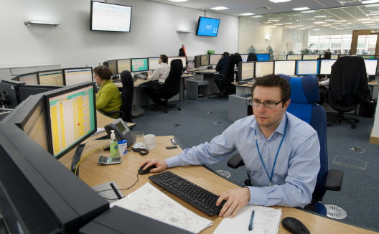
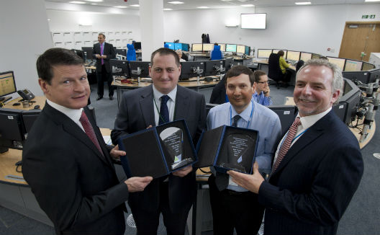
Distribution Network Control Centre Overview 2014

Slide 20

Gas Transportation & Distribution
Connecting you to your energy today, trusted to help you meet your energy needs tomorrow
Distribution Network Control Centre (DNCC)
  Deliver gas from the National Transmission System (NTS) to our customers safely and reliably:
    forecast the gas demand and reserve NTS capacity to deliver it
    operate the distribution system 24/7 and 365 days a year.

Slide 21
Beach to Meter
LTS
Salt
High pressure
Suppliers/Shippers/GNCC
cavity
storage
Terminal
storage
LGT
38
85
LDZ Offtake
Compressor
Regulator
Station
7
Users
Industry
DN Controlled
LNG
Storage (-161 C)
Governor
2
Users
Low Pressure
Storage
0.5
Terminal to LDZ Offtake – GNCC
Offtake to customer - DNCC
Notes:
Walk through
Salt Cavity - Underground salt formations are well suited to natural gas storage. Salt caverns allow very little of the injected natural gas to escape from storage unless specifically extracted.
The walls of a salt cavern are strong and impervious to gas over the lifespan of the storage facility.
Salt domes used as underground storage tanks
HP Bullets - These are large cylindrical pressure vessels. An extension off of a High Pressure pipeline. Pressure within the bullet increases overnight. Gas is released by regulating it out onto
a lower pressure network during the day.
Low Pressure Storage - Capable of holding large volumes at low pressure. Local points of storage, gas can only be used in immediate vicinity to the holder.
Liquefied Natural Gas - Liquefied Natural Gas (LNG) is, as its name suggests, natural gas in its liquid form. LNG is formed by chilling gas to -161˚C so that it occupies
600 times less space than in its gaseous form. This makes it an ideal way of storing and transporting large volumes of gas from countries such as Algeria, Trinidad and Qatar.
LNG is essentially the gas used to heat our homes and businesses, cook our food and provide us with a warm shower. When it is needed as gas it is simply warmed up on site and put into the National Gas Transmission System for use in UK homes and industry.
Compressor - The purpose of a compressor station is to boost the pressure in a natural gas pipeline and move the natural gas further downstream
LGT - Natural gas is odourless when piped from the North Sea. Injection now takes place at the offtakes and is known as Local Gas Treatment (LGT).

Slide 22
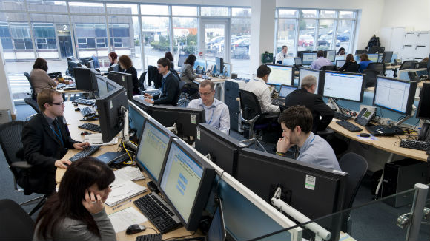
DNCC
Support Office Functions
Commercial
Commercial impacts
Demand Forecasting
Contracts & Incentives
Assurance
Business Assurance & Risks
Emergency Preparedness & Management
BCM Preparedness
Best Practice
Resilience
Operating Strategy
NRO Management
Summer & Winter Operation Plans
Prepare for maintenance on Gas Distribution Systems
SCADA/Telemetry Support
Notes:
To formulate an Operating Strategy: interaction is critical – awareness of forthcoming plans for major work and configuration changes ensures operators are informed and prepared, and systems can be tested (in conjunction with advice from Network Planning).
Commercial: decision making tools, used in real time, just add to the mix in the thought process
Assurance: compliance and contingency preparedness are also part of our training to ensure the team are ready for anything

Slide 23
What does RIIO mean to DNCC
What are our drivers;
  Deliver in the most efficient way
  Maximise revenue with continued focus on customers and stakeholders
  Think how to do things differently
What will we do?
  Deliver efficient and effective processes
  Manage our NTS Exit Capacity bookings
    Responsible for purchasing our capacity requirements
    Financial penalties in place for overrunning
    Incentives in place to encourage efficient booking of capacity requirements
      Shared with our customers
  Continually review and improve

Slide 24
Facilitating the Future
Sustainable Gas – Stakeholder Delivery
8 October 2014
Steven Haskayne
Notes:
24

Slide 25
National Grid Gas Distribution
Owner and Operator 4 Gas Distribution Networks
190,000 kilometres of Gas Distribution Pipelines
Operate 24/7 Emergency Service
Deliver Connections to our networks
We serve 11 million customers
National Grid is striving to reach its target of an 80% reduction in carbon emissions by 2050.

Slide 26
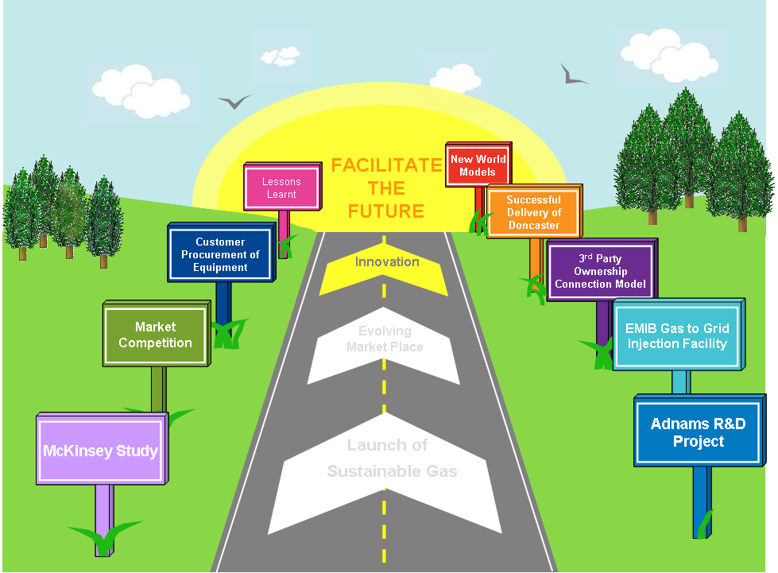
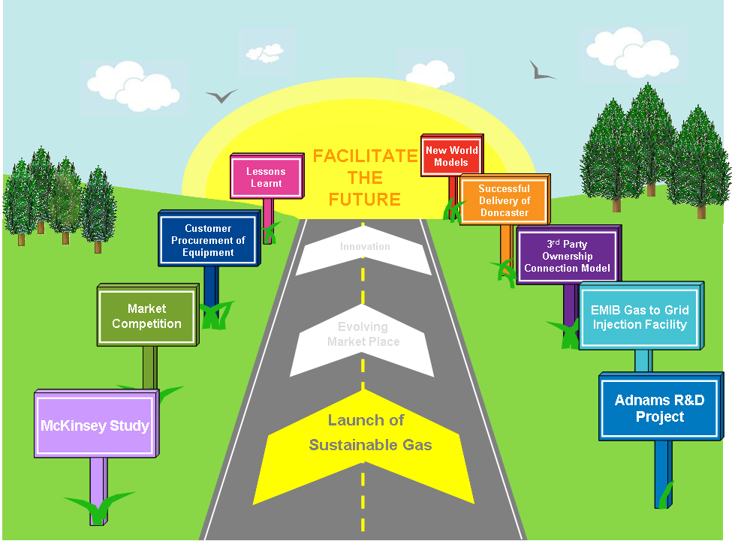
Our Journey

Slide 27
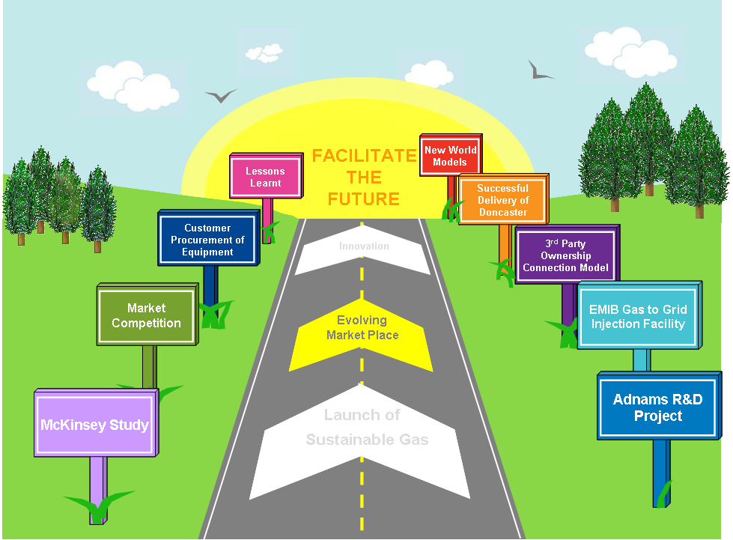
Our Journey

Slide 28
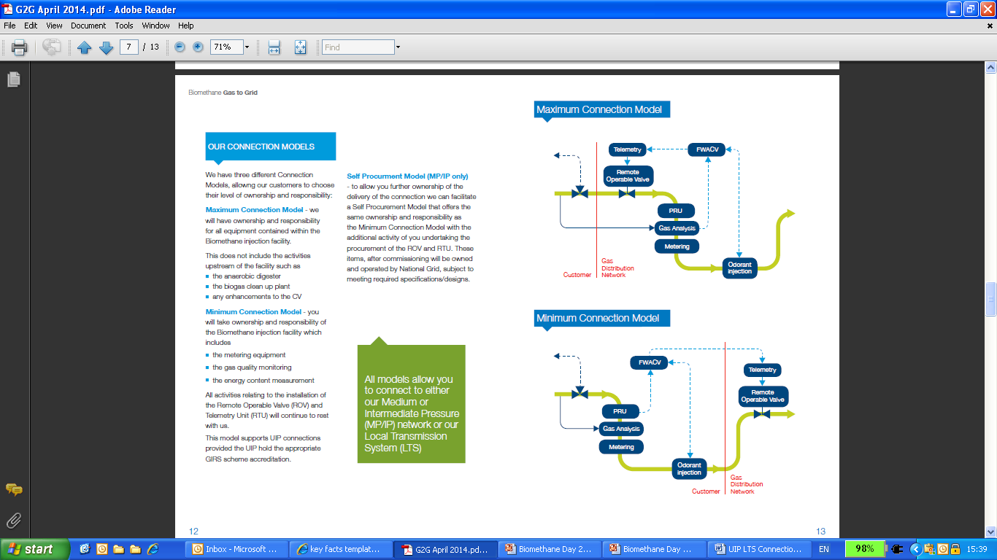
Connection Models – the evolution
Maximum Model
Minimum Model
What Next?
Maximum Model
Minimum Model
National Grid manages the end to end delivery of the connection
  Injection facility procurement from our approved framework agreement
  Connection Design
  Pipeline connection
National Grid will own, operate and maintain the
injection facility
Enables customer choice/market competition
Customer procures direct the Injection facility from our approved vendors and is responsible for its operation and maintenance
Network Entry Agreements – development of 3rd party contractual operational requirements
Support UIP Connections (does not include LTS connections)

Slide 29
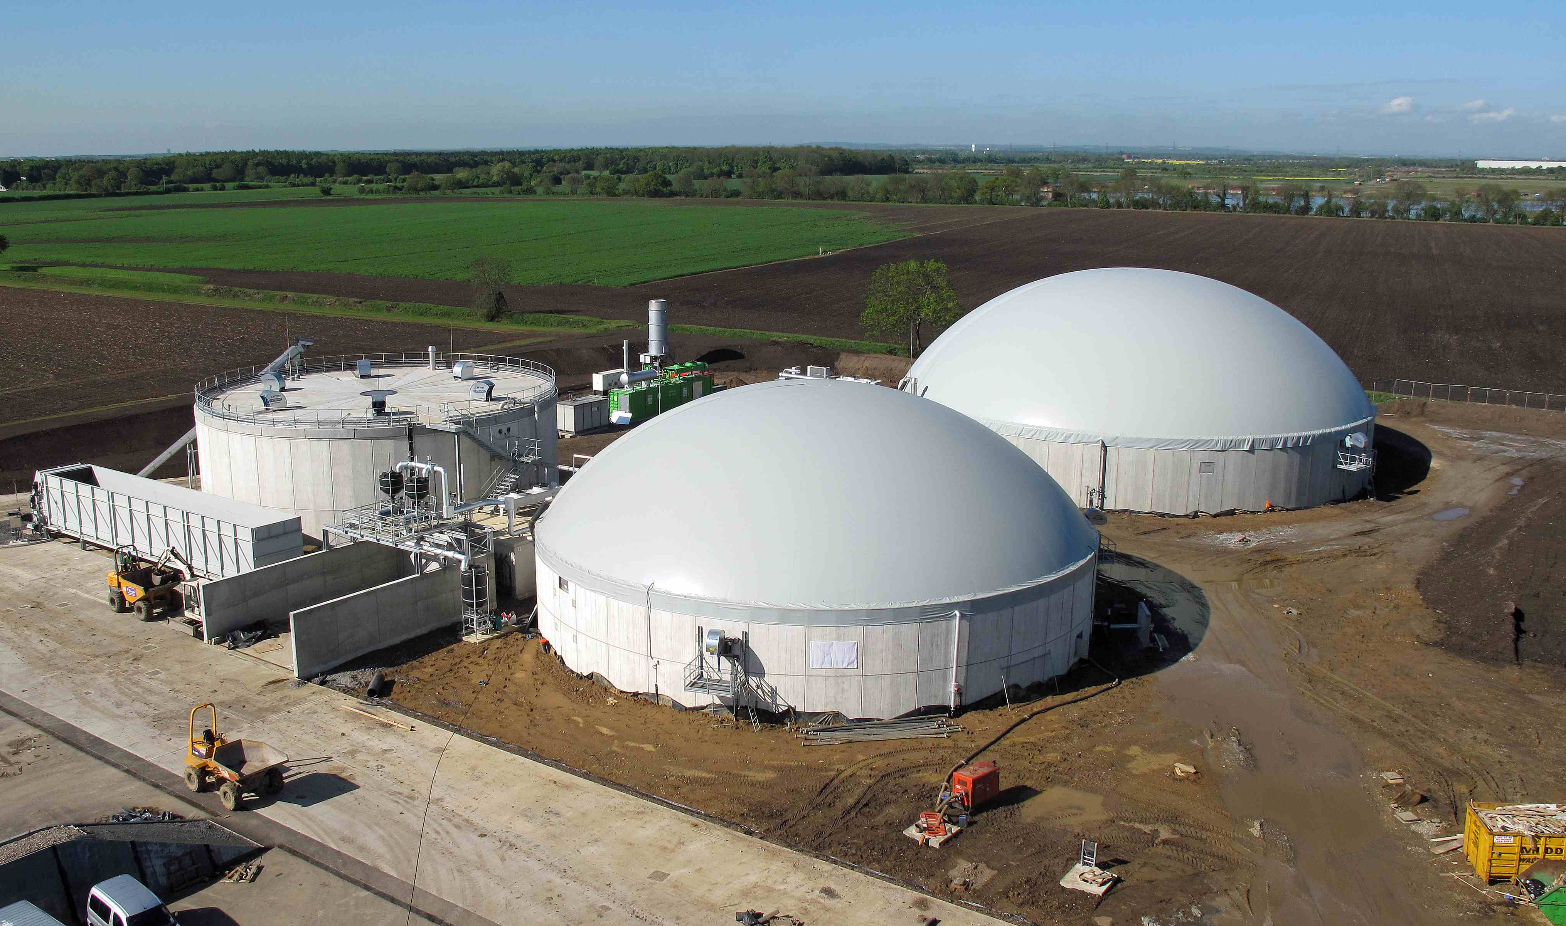






First Commercial 3rd Party Owned and Operated Bio-gas Project Connected
Key Numbers
  350m3 Gas + 500KW Elec
  35,000t agricultural feedstock
  15 local farmers
  2 full time staff
Biogas
Plant
Renewable Gas for:
3,500 local homes in Winter
50,000+ homes in Summer !!
28,000 tonnes of
organic fertiliser

Slide 30
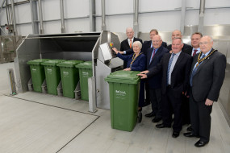
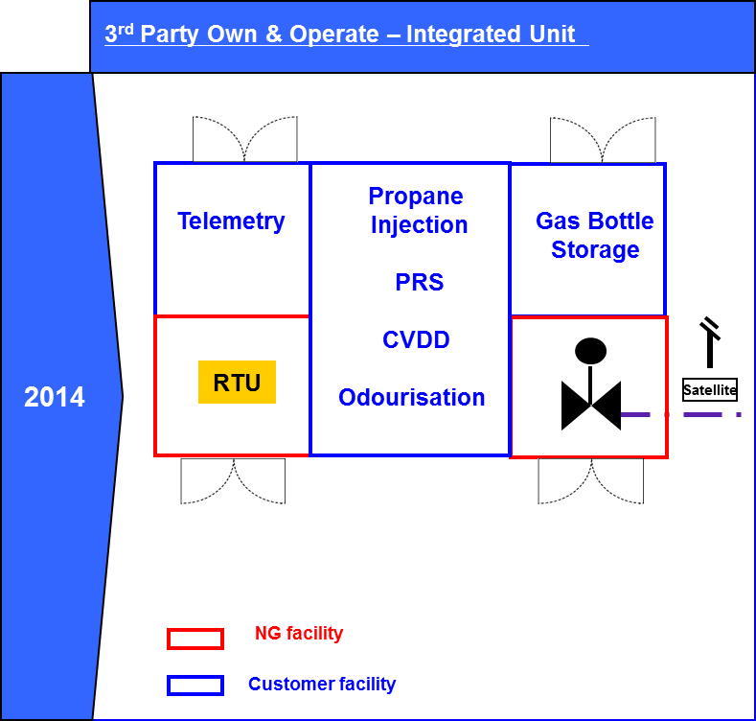
First commercial single integrated kiosk
Bio-gas project
2nd commercial sustainable gas connection
First ‘single box’ integrated connection model
Commissioning - Flowed gas on 27th June 2014
Flow rate: 1231 scmh
Food Waste – 90,000 tonnes of supermarket & domestic council waste

Slide 31

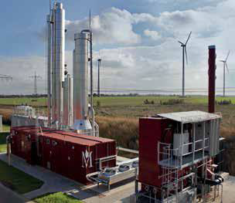
First Commercial commercial project connected to our >7barg (LTS) network
First Commercial project connecting to our LTS Network
Located in Sutton Coldfield, Birmingham
Process c.4000 m3/hr sewage
16 Anaerobic digesters on site
Flow Rate: 900 scmh
Notes:
National Grids first commercial project connecting to above 7 barg network
Minworth is STW Largest treatment works
STW process 4000 m3/hr of sewage sludge
Sludge is from the Birmingham area
16 AD plants on site processing the sludge
Plant flows 900 scm/h of gas back into the grid

Slide 32

Our Biomethane Sites
Confirmed projects will heat
8223 homes
580 Enquiries
Since April 2012
Doncaster
Hibaldstow
68 projects
Stockport
Scampton
Progressing through process
Widnes
Holkham
8 projects
Raynham Farm
Minworth
Under
construction
Sotterley
West Fen Farm
Chittering
5 Projects Connected and Commissioned
75 to Go!
Adnams
Euston Estates

Slide 33
Our Journey

Slide 34
Connection Models – the evolution
Launch
Evolving
market place
Innovation
Lessons learnt
Innovation
Customer and Internal Stakeholder Engagement
Review lessons learnt from Doncaster project
Analyse and Identify areas for development and opportunities
  Initial Enquiry – very fast
  Detailed analysis study
  Connection Agreement – the deal
  Network Entry Agreement – no pre-accreditation
Process Improvement Strategic Plan
Problems solved
  GS(M)R derogation allows up to 1% O2
  in <37 bar
  Speed of connections – months
  not years
Innovative technology solutions
  HPPE PIPE
  >7bar Self Lay Connection
  Integrated Injection Unit
Customer choice
Ease and efficiency of connection
Reduced Cost to Serve

Slide 35
Innovation – Integrated Injection Unit
3rd Party Own & Operate – Integrated Unit
Model at Hibaldstow (Future Biogas), Widnes (ReFoods), Chittering (Pretoria Energy)
Allows the complete BtG facility to house customer & NG Assets (RTU & ROV) in one kiosk
NG sole access to NG facilities
Reduce cost to the customer and streamlined delivery.
Reduced land requirement and any possible planning objections
Customer control of supply chain.
2014
Telemetry
Propane
Injection
PRS
CVDD
Odourisation
Gas Bottle
Storage
RTU
Satellite
Outlet to Network
NG facility
Customer facility

Slide 36
Newly refreshed website
Available at: http://www2.nationalgrid.com/UK/Our-company/Gas/Sustainable-Gas/
Includes key information such as:
  Our Customer guide to connect
  Eight key steps to connect and what you can expect at each stage of the project
  Connection Models & what options are available
  Our project portfolio map

Slide 37
Thank you

Slide 38
Firm Load Shedding Overview
Notes:
Introduce yourself.

Slide 39
Firm Load Shedding Agenda
  What is Interruption and Firm Load Shedding
  Interruption Reform
  Process
  Exercise Viper results
  Continual Improvement
  Questions

Slide 40
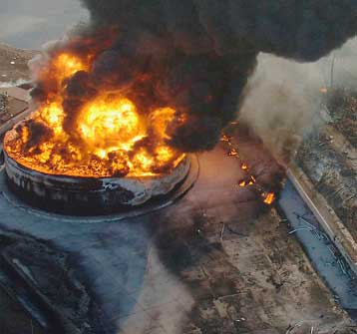
Firm Load Shedding
Firm Load Shedding is used during Gas Supply Emergencies, as a means of reducing non domestic sites gas usage in order to maximise gas supplies to priority and domestic consumers
Notes:
Explain what a Gas Supply Emergency is and how Firm Load Shedding is implemented.
Firm Load Shedding is used during a Gas Supply Emergency as a means of reducing non domestic sites gas usage. A Gas Supply Emergency is caused by insufficient gas supplies being available to satisfy expected demand and could be caused by a number of factors. Although the probability of this occurring is very low, insufficient supplies could result in a loss of pressure in the Network to all types of consumers that would require prompt and appropriate action to prevent any dangerous occurrence. The Network Emergency Controller or the gas transporter can declare a Gas Supply Emergency. These emergencies can be classified in 3 groups, Critical Transporter Constraints, Emergency i.e. damage, or a Gas Deficit Emergency

Slide 41
Firm Load Shedding
 | Network Gas Supply Emergency Classification
 | Gas Deficit: Insufficient Gas Supplies Available to the NTS |  | Critical Transportation Constraint in the NTS
Emergency Stage | Gas Deficit Emergency | GSMR Monitor Breach | Critical Transportation Constraint
1 (Potential) | Emergency Spec Gas NTS Linepack Distribution Network Utilisation Distribution Network Storage Emergency Interruption Public Appeals | Instruct shippers & storage operators to amend storage flows Public Appeals | Emergency Spec Gas NTS Linepack Distribution Network Utilisation Distribution Network Storage Emergency Interruption Public Appeals
2 | National Grid Gas plc’s participation in the OCM will be suspended Maximise Supplies Firm Load Shedding | National Grid Gas plc’s participation in the OCM will be suspended Maximise Supplies Firm Load Shedding | Maximise Storage Firm Load Shedding
3 | Allocation & Isolation | Allocation & Isolation | Allocation & Isolation
4 | Restoration
Notes:
Firm load shedding is an integral part of National Grids safety case during a Network Gas Supply Emergency. However, as you can see from this slide, it is not the first action that would be undertaken to ensure gas supplies.
Dependant on the type of emergency, National Grid would implement the following procedures in order to safe guard supplies and the integrity of its networks.
Emergency Spec Gas – Widened CV values
NTS Line Pack – Increasing the gas stored in the national distribution network.
Distribution Network storage – Increasing the gas stored in the distribution networks.
Emergency interruption – Interrupting the remaining interruptible sites
Public Appeals – Asking the public to reduce the amount of gas they use
Suspension of OCM – National Grid would cease to trade on the on day commodity market
Instruct shippers and storage operators to amend storage flows.

Slide 42
Interruption Reform – What is it?
Interruption Reform changed Interruptible contracts to Firm Load contracts
The majority of sites are now Firm
Distribution Networks are requested to be able to Firm Load Shed 10% of network load within 4 hours of a Gas Supply Emergency
Notes:
Interruption Reform 2011 changed the majority of interruptible contracts to firm contacts, with the majority of these customers transferring to Firm Load contracts by October 2011.
Within Distribution Networks it is needed to firm load shed 10% of Network load within 4 hours.
Only 3 small sites which are interruptible

Slide 43
Process
Distribution Network’s begin Firm Load Shedding process based on target load requested
National Grid Customer Operations perform FLS
  Sites are contacted directly, largest Site Offtake Quantity first
  Sites are requested to stop using gas
    Successful Firm Load Shed
    Unsuccessful Firm Load Shed
Notes:
National Grid will perform Firm Load Shedding by contacting sites directly, largest SOQ (Site Offtake Quantity) first. These contacts are made across all networks and shippers simultaneously within the target area. All sites contacted are recorded as successful or unsuccessful firm load shed.
Successful contacts during this process are customers who can turn off or initiate shutdown procedure. Unsuccessful contacts are customers who are unable to turn off their supply, have incorrect contact details, or unable to contact an authorised person who could order the turn off of the supply.
Sites unable to turn off their gas supply may be contacted a second time to ensure they understand the consequences. Failure to comply with the Direction notice could lead to physical isolation by a Distribution Network operation team. Such failures to comply with such Direction notices could lead to these customers being reported to the HSE and their suppliers. Progress of Firm Load Shedding is reported during the incident

Slide 44
Process
44
Distribution Network’s begin Firm Load Shedding process based on target load requested
  1000 sites were contacted
  4544 Calls made
  3827 Call Agent
  717 Escalation Agent
Notes:
National Grid will perform Firm Load Shedding by contacting sites directly, largest SOQ (Site Offtake Quantity) first. These contacts are made across all networks and shippers simultaneously within the target area. All sites contacted are recorded as successful or unsuccessful firm load shed.
Successful contacts during this process are customers who can turn off or initiate shutdown procedure. Unsuccessful contacts are customers who are unable to turn off their supply, have incorrect contact details, or unable to contact an authorised person who could order the turn off of the supply.
Sites unable to turn off their gas supply may be contacted a second time to ensure they understand the consequences. Failure to comply with the Direction notice could lead to physical isolation by a Distribution Network operation team. Such failures to comply with such Direction notices could lead to these customers being reported to the HSE and their suppliers. Progress of Firm Load Shedding is reported during the incident

Slide 45
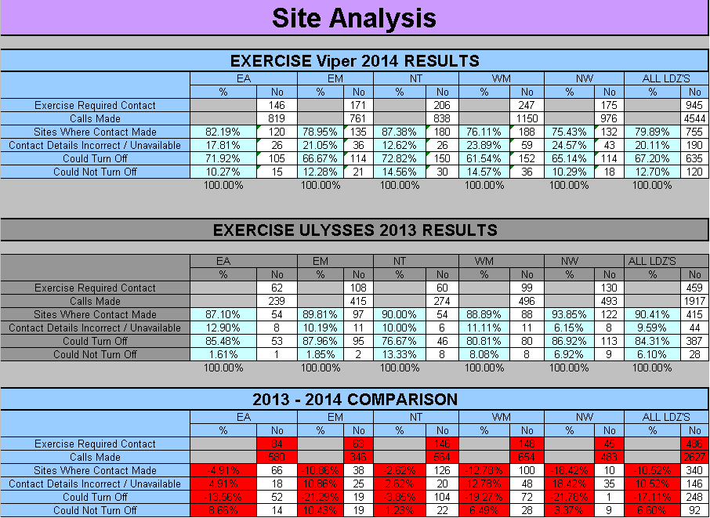
Exercise Viper 2014 results
Notes:
Exercise Ulysses was the annual Network Emergency Coordinator Emergency Exercise and was performed in September 2013.
Talk about success in green and areas that have slipped in red
Every site that can not cease to use gas, either because they can not be contacted or can not stop using gas, means that we have to contact more sites in-order to reduce demand. This might mean contacting an extra 5 sites per 1 site that can not cease to use gas.

Slide 46
Comparison of Exercise Viper and Exercise Ulysses
Exercise Viper 2014 has shown an reduction in overall results compared to Exercise Ulysses 2014
    The number of sites able to be contacted decreased by 10.52%
    Sites that could stop using gas decreased 17.3%
    Sites that could not / refused to stop using gas decreased by 6.60%
    Sites with incorrect contact details or unavailable increased by 9.4%
Notes:
Exercise Titan has shown an improvement in overall results compared to Exercise Saffron. The following high level results have been identified.
The number of sites being able to be contacted increased by 19.63%.
On average, 3.5 calls were made per site in order to establish contact.
Sites that could stop using gas increased by 13.45%.
Sites that could not/ refused to stop using gas increased by 6.31%.
Sites with incorrect contact details or unavailable decreased by 19.76%.
The number of sites, that were unavailable and could not turn of combined, has decreased by 13.45%
Exercise Titan has highlighted certain disparages in the individual performance of Networks, with North Thames (NT) performing poorly when compared against the other Networks. However, it must be noted that NT has shown an overall improvement in successful contacts compared to Exercise Saffron. More sites were needed to be contacted in NT than previous years, due to the change in the request for load shedding being based on reducing the total Network demand, rather than a number of sites

Slide 47
Validation 2014
Each Year NG validates the top 200 sites per Network
    During validation it became apparent that various sites should have been potentially listed as Priority Consumers.
    During the exercise it became apparent that the amount of gas each site uses is not up to date.
    Each site that is unable to turn off could result in smaller non- domestic consumers have to be contacted
Notes:
Each Year NG validates the top 200 sites per Network as part of the safety case
Some Hospitals are listed after speaking with them they thought they would be listed as priority consumers. Some MOD sites are unable to be contacted.
During validation a site had been taken over by a smaller company however the old gas usage details were being supplied.
There were 34 sites which were successful in 2013 but unable to cease this year (interesting side note, these 34 sites use more gas than the bottom 170 which were called during the exercise)

Slide 48
Continual Improvement
What has National Grid undertaken to improve performance of FLS?
  Data Validation
  Making customers aware of their obligations
  Single point of contact for FLS at National Grid
  Escalation agents
  Informing suppliers of inaccurate data
  Introducing an electronic FLS system IES
  Introducing Grouped Sites
  Feedback given to the shipper of those sites which were unable to cease.
Notes:
Continual Improvement – National Grid are committed to continually improving our performance in FLS exercises, by identifying areas in which improvements can be made. we have implemented the following improvements.
Data Validation – Contacting the top 200 gas consumers in each network by telephone, before commencement of Exercise Ulysses in September 2013 and storing data from confirmed contact details. Over 1000 sites contacted.
Obtaining customers email address – To improve future data validation- so we can pre-warn of impending exercise, to clarify yearly they are still the correct contact and number correct
Making customers aware of their obligations – Providing Emergency Contact Leaflet for reference.
Single point of contact for FLS at National Grid – Providing support for customers questions.
Escalation Agents – Supporting customers during FLS. Provide more in depth knowledge of FLS procedure.
Informing suppliers of inaccurate data – 5 sites stated they don’t use gas. Incorrect contact details.
Introducing an electronic FLS system IES – To support real time data inputting, removal of manual forms, constantly calculates sites to call.
Introducing grouped sites – Identifying sites with multiply SPID and grouping them under 1 set of contact details.

Slide 49
Continual Improvement
49
Success of Firm Load Shedding is based on continual process improvement
Accurate site contact details
Sites being aware of their responsibilities
Notes:
Continual Improvement – National Grid are committed to continually improving our performance in FLS exercises, by identifying areas in which improvements can be made. we have implemented the following improvements.
Data Validation – Contacting the top 200 gas consumers in each network by telephone, before commencement of Exercise Ulysses in September 2013 and storing data from confirmed contact details. Over 1000 sites contacted.
Obtaining customers email address – To improve future data validation- so we can pre-warn of impending exercise, to clarify yearly they are still the correct contact and number correct
Making customers aware of their obligations – Providing Emergency Contact Leaflet for reference.
Single point of contact for FLS at National Grid – Providing support for customers questions.
Escalation Agents – Supporting customers during FLS. Provide more in depth knowledge of FLS procedure.
Informing suppliers of inaccurate data – 37 sites unable to contact before exercise Titan. Shippers informed of incorrect data and asked for clarification, with shippers not responding. Shippers asking National Grid for their clients contact details.
Introducing an electronic FLS system IES – To support real time data inputting, removal of manual forms, constantly calculates sites to call.
Introducing grouped sites – Identifying sites with multiply SPID and grouping them under 1 set of contact details.
Success of Firm Load Shedding – We need suppliers to ensure they undertake regular updates of sites contact details as we have some data information that is currently inaccurate. The results we have achieved during exercise Titan has highlighted the effect of accurate contact details. However, these details on the whole were obtained by National Grid.

Slide 50
Firm Load Shedding
Questions
Notes:
Any Questions?

Slide 51
Customer Centre Overview
October 2014

Slide 52

Customer Centre Overview
The National Grid Customer Centre provides 24/7 365 service allowing UK customers to report gas emergencies.
It employs circa 335 people working multiple shift patterns across 2 operational sites
In addition to providing an emergency call handling service it also carries out a number National Grid specific roles including –
  Complaint Management
  Enquiry Management
  Plant Protection
  Shop on behalf of (SOBO)
  SSR incident desk
Notes:
Welcome, Who I am, what is GT
We have various elements to our customer centre
- Complaints and Enquiries – Ensure when we don’t get it quite right we have a team who understand to help out customers and rectify the problem
- Plant Protection – Helping people who need to check if any of our assets are where they want to dig/build
SOBO – providing a service to our engineers to ensure they have everything they need to deliver a great service to our customers
SSR provides a safety reporting for our teams to ensure we are investigating and sharing best practice

Slide 53

Performance
How did we do last year?
  Answered 2.4 million calls
  Emergency Line 1.6 million
  8 seconds ASA on the Emergency Line
  Enquiry Line 153,000
  M Number 650,000
  93.87% SOS on our regulated lines
  GT ID & ARH 53,354
Notes:
On the Emergency GT team last year we answered 2.4 million calls. SO far this year we have answered 1.1 million.
Answered 1.1 million calls against a forecast of
Emergency Line 692,000
8.5 seconds ASA on the Emergency Line
Enquiry Line 73,001
M Number 397,323
93.74% SOS on our regulated lines against a target of 90% for the year
GT ID & ARH 15,606

Slide 54


Current Initiatives
Winter Preparedness
Health and Wellbeing
Performance Excellence
Collaborative working with GDNs
Notes:
Preparation for Winter including making sure all back office staff are skilled to take emergencies, utilising our telephony system to allow us to overflow emergency calls. 4x4 vehicles are available to move staff to and from site and new starters have flexible contracts to meet Customer demand.
Health and Wellbeing programme – Moving away form the traditional vending machines and encouraging our teams to live a healthy lifestyle. We have a fruity Friday, ’, health kiosk in the canteen and suitable healthy recipes.
Performance Excellence – truly understanding our Customer and Stakeholder requirements, measuring our performance and driving continuous improvement will talk more about this on the next slides
Working with the other GDN’s to provide the best service for our customers, this includes sending our surveys to get an open and honest communication to improve our relationship and service

Slide 55
Performance Excellence

Slide 56
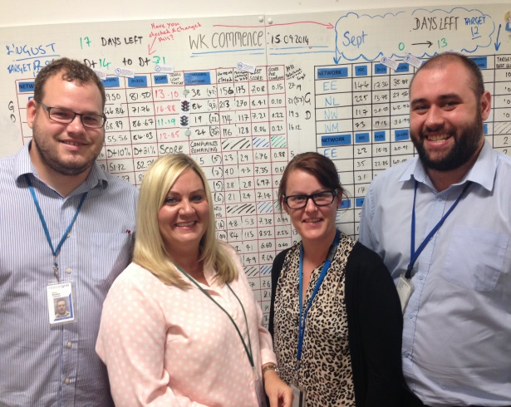
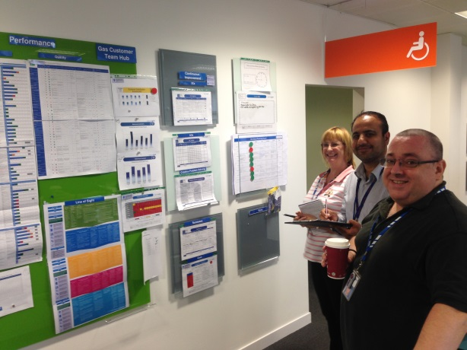
Visual management and workplace audit
Embed
Sustain
Coach
Notes:
Daily conversation across all teams help us identify ways to share best practice and improve our performance for our Customers
All performance measures are made visual
Each Team has people skilled in problem solving
Workplace audit is carried out by all levels to ensure our teams are receiving the right level of support and coaching.

Slide 57
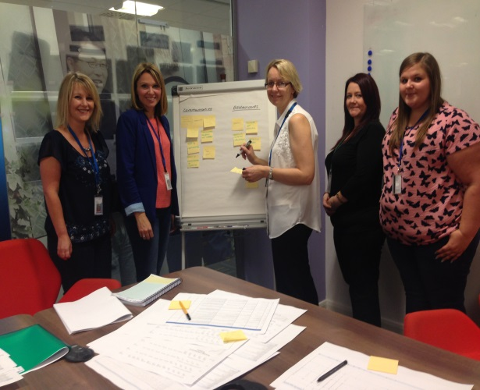
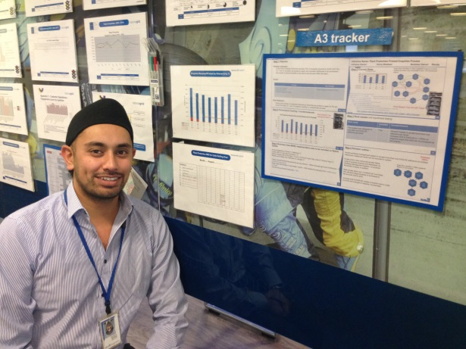
Structured approach to problem solving
Creative problem Solving (CPS)
A 3 Projects
Daily Conversations
Notes:
We have a structured approach to problem solving to make sure we get to the root cause of the problem
We use a formal CPS approach to departmental problem
For cross functional problems we use the A3 document
All benefits from problem solving events are tracked through our daily conversations to make sure we deliver the expected performance and deliver the customer benefits.

Slide 58
Customer Centre – Plant Protection

Slide 59

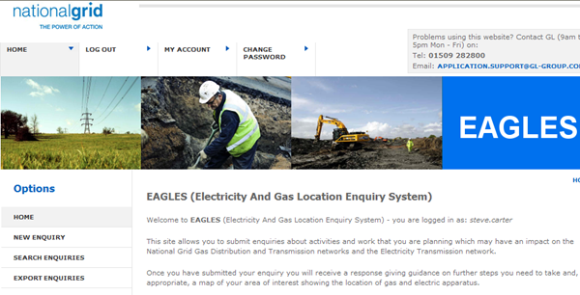
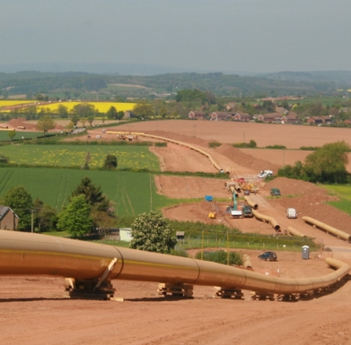
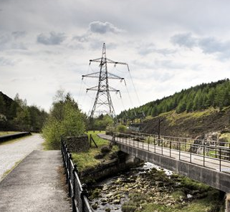
Plant Protection
What do we do?
What is our objective?
EAGLE’S
Notes:
Our Role:-
We are a Customer facing department within the Customer Centre that offers a service to anyone who wants to know the location of apparatus at a proposed site.
This is a safety critical process
Our Objective:-
To communicate accurate information of National Grid’s Transmission and Distribution assets in a clear, timely manner, while safeguarding our customers and communities to the highest standard
EAGLES
EAGLES (Electricity and Gas Location Enquiry System)
Each enquiry submitted generates a formal response
Risk Score – High, Moderate or Low
Guidance and Regulations
Map of Asset Affected
National Grid Team Contacts
September 2013 EAGLES went external allowing customers to self serve
2168 Organizations consisting of 5493 customers have registered to use the system
September 2014 saw the highest number of enquiries inputted by external customers 8901
You may have noticed throughout this presentation there is a picture of ‘Mrs Miggins’. Mrs miggins is our customer, we have several initiatives in the Customer Centre to help our teams improve the service the provide to the customer. Please take a look when you go upstairs

Slide 60
Notes:
You may have noticed throughout this presentation there is a picture of ‘Mrs Miggins’. Mrs miggins is our customer, we have several initiatives in the Customer Centre to help our teams improve the service the provide to the customer. Please take a look when you go upstairs

Slide 61
Dispatch Centre / Resource Management Overview

Slide 62
Operating Model
Gas Distribution Common Operating Model
Performance
Commercial
Network Strategy
Customer Operations
Operations
GDSP
Emergency Response and Repair
Operations
Governance
Strong safety performance
Engaged and developed people
Efficient and compliant processes
Satisfied customers
Operate and Maintain
Replace and Extend
Corporate and Shared Services
Culture

Slide 63
There are four key areas within Customer Operations
Accurate sizing of the on day field force
Meeting our customer’s needs
Get the field force to their job right first time
Getting the most out of GDFO
Operational Planning
Long and short term planning of work and resources
Customer Centre
A single point of contact for customers via phone, letter or new media
Dispatch
Centre
Managing the day to ensure that the right person gets the right job at the right time
Business Solutions
Management Information and support for GDFO systems and asset data repository
Resource Management, Maintenance RM&D
Customer Centre
Repair Dispatch, Emergency Dispatch
BCD, Data Assurance

Slide 64
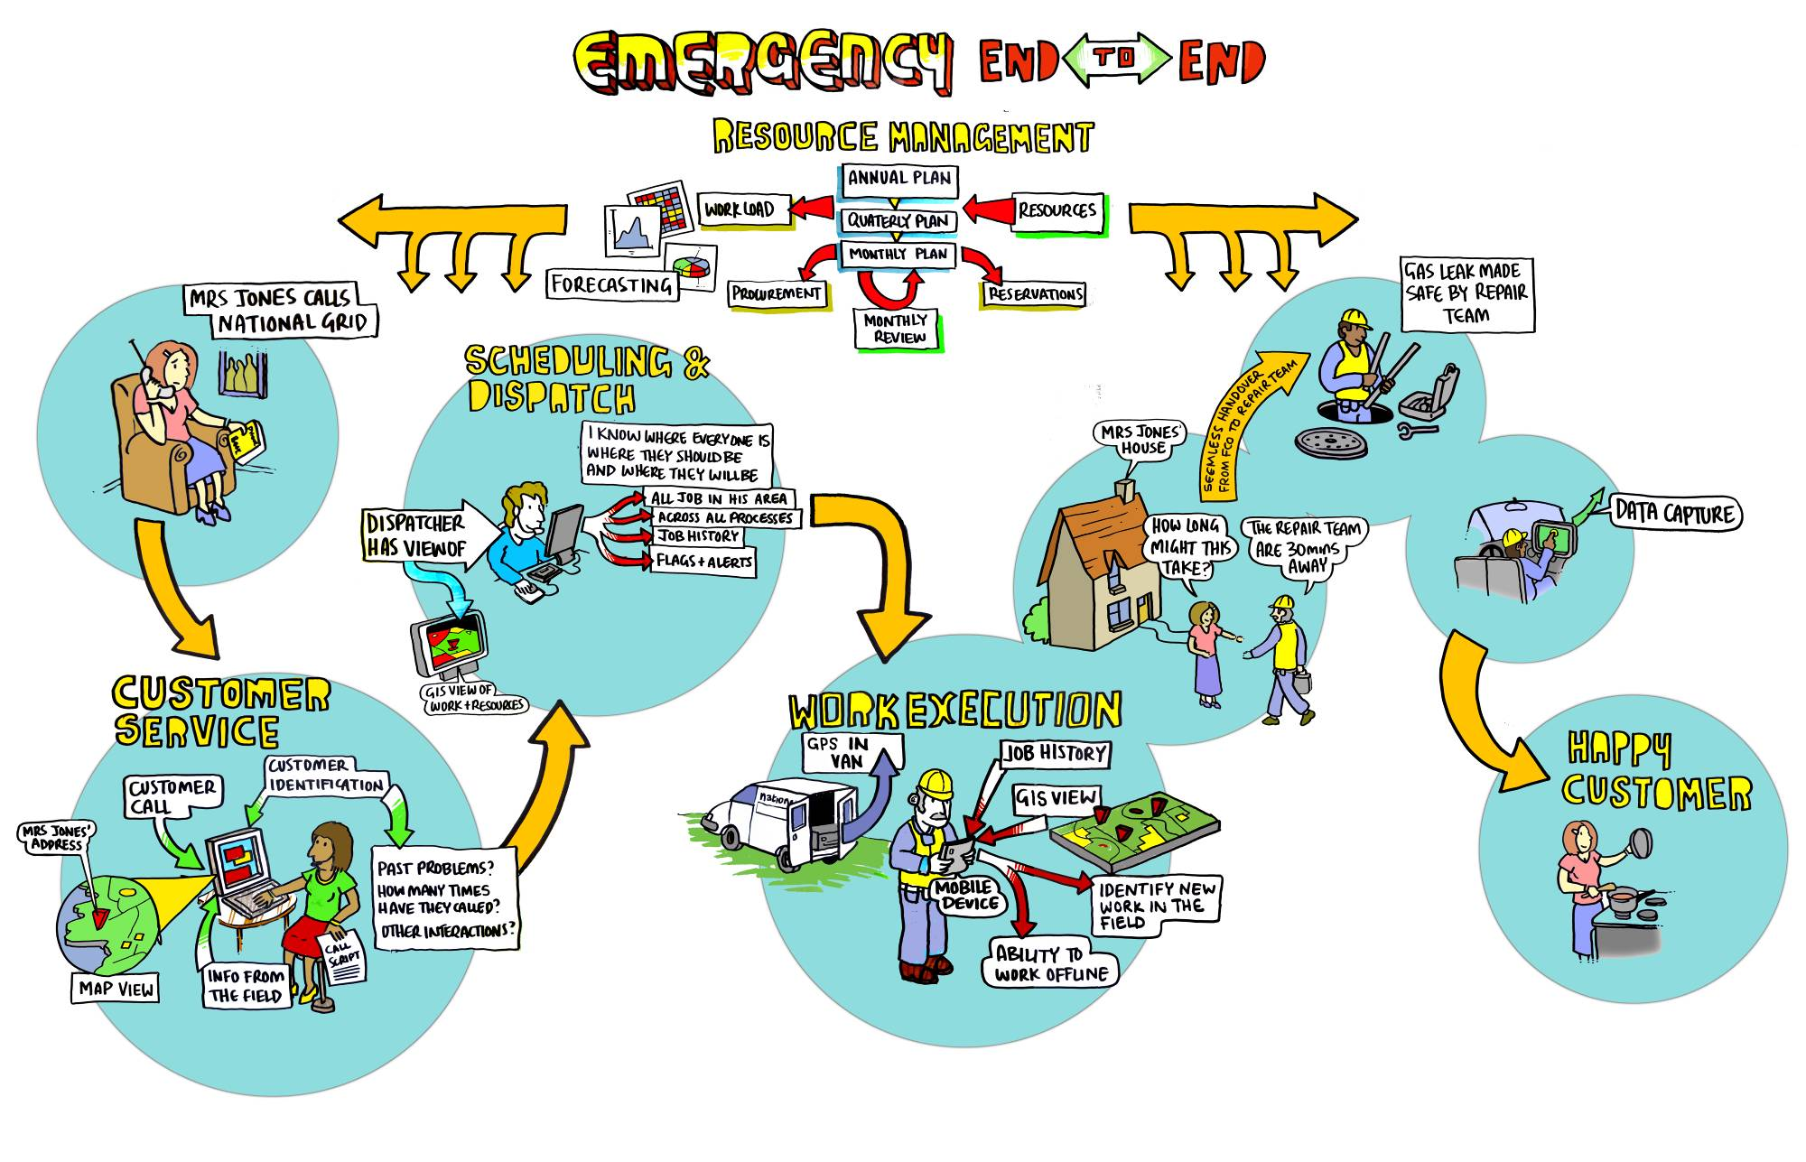

Slide 65
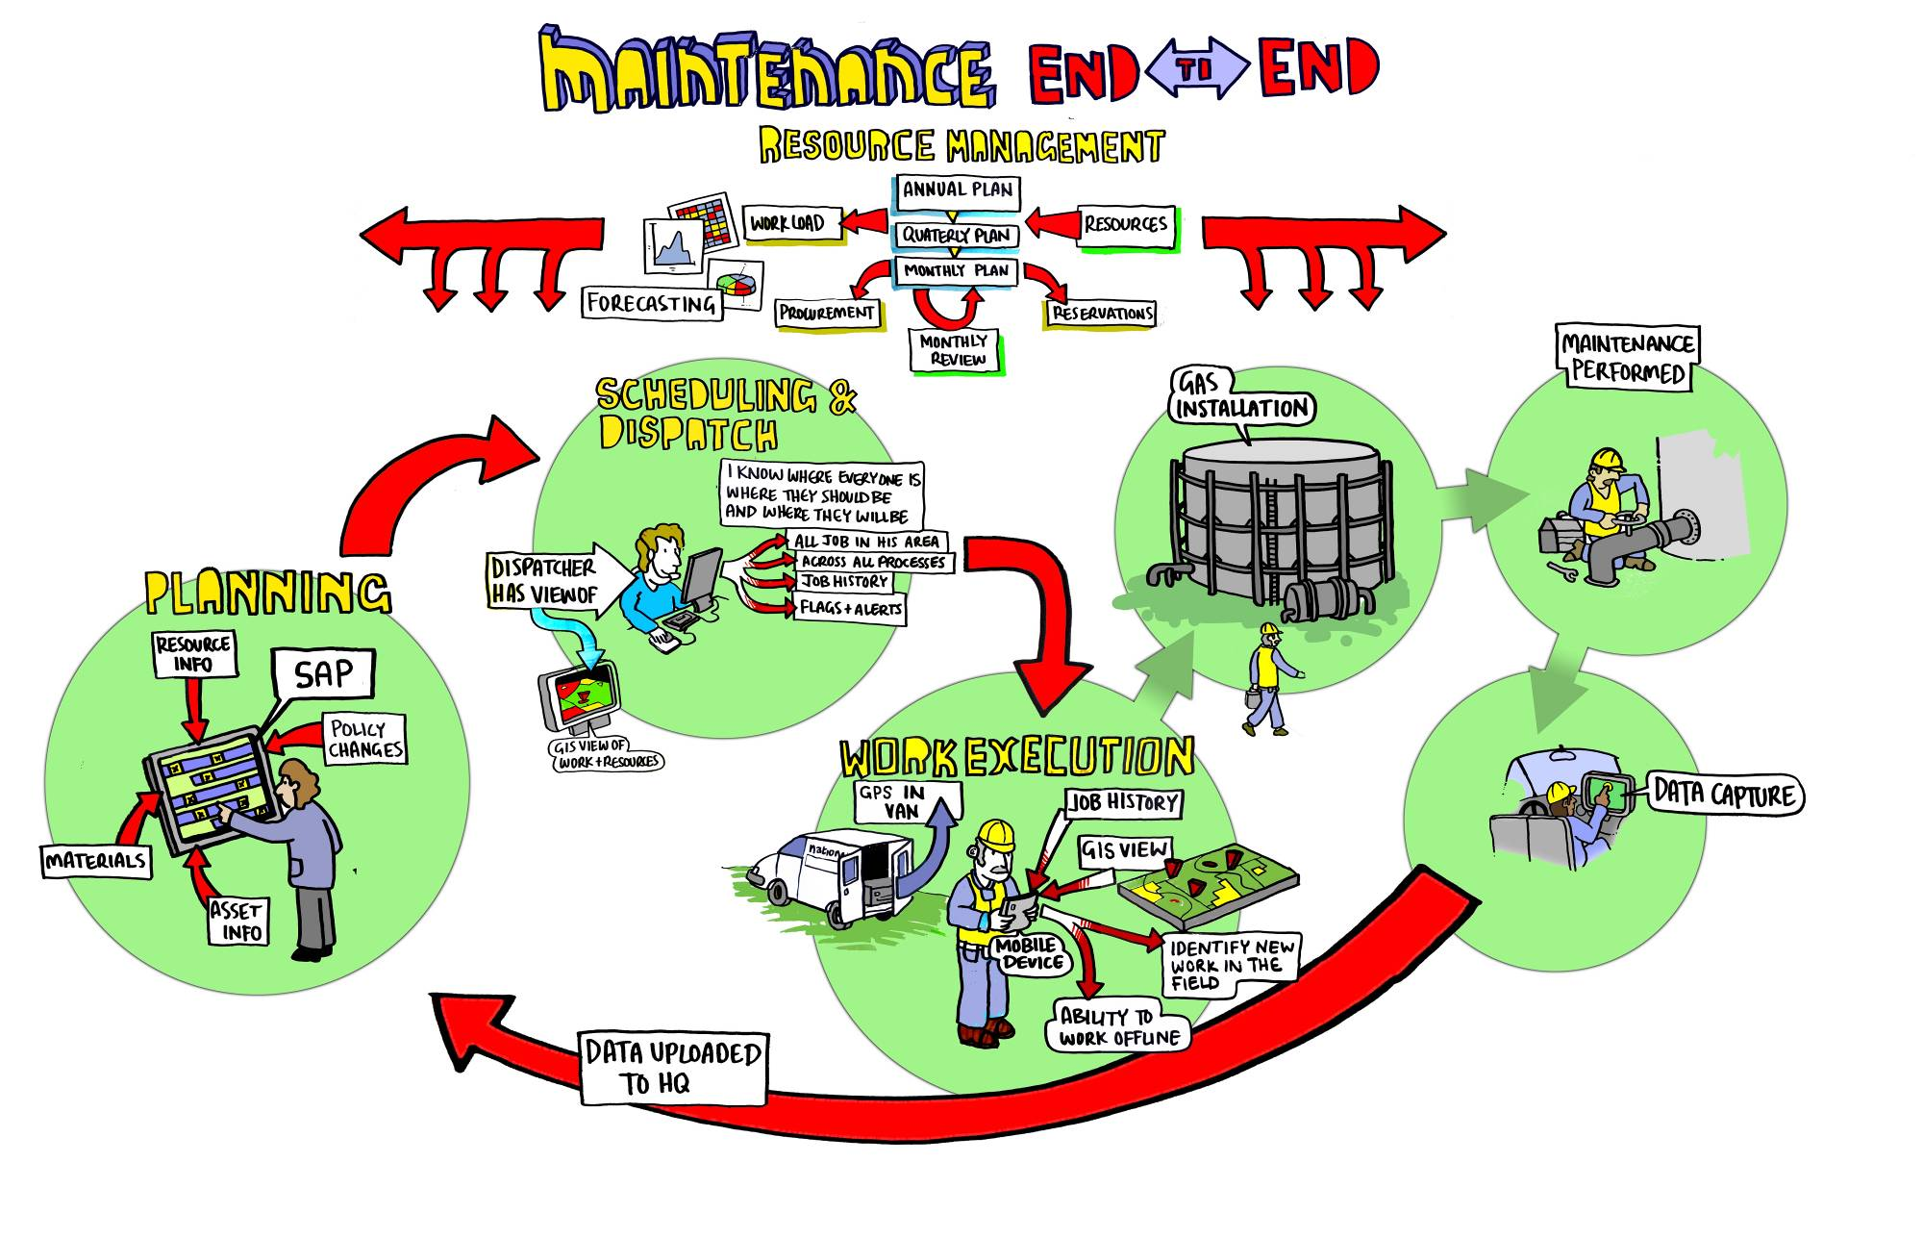

Slide 66
Planning & Dispatch Process
Forecast
Plan
Schedule
Dispatch
Use historical workload information to predict the ‘Reactive’ workloads outside of our control
Work with Customers & Stakeholders to ID the known workloads – and balance Resources against them.
This is done Annually down to D-1
Optimise the work schedule from D-35 to D-1 – putting names to jobs where necessary
Meet with dispatch to handover the plan for the following day/week
Dispatch the workload according to the resource management plan.
Feed back where necessary to improve on the forecast

Slide 67
Resource Management
Forecast, Plan & Schedule reactive & planned workloads for Emergency, Repair & Maintenance
Drive performance in Operations using Analytical, operational and Planning expertise
Accurate forecasting of reactive workload
Risk based scenarios & contingencies
Work order creation / processing
Creation of optimised schedules (D35 to D1)
Managing field force absence to minimum numbers
Creation of deliverable annual plans
Work load tracking and analysis
Planned work phasing e.g. PME
Creation and management of optimal field force shift patterns
Scheduling of field force unavailability e.g. vehicle servicing
Accurate sizing of the on day field force (to deliver the business plan)

Slide 68
'Other Work' covers D2s,GSRs, & Extend Supply
'EWMS' covers Check For Safety, Other Support, & Purge & Relight

Slide 69
UK Overview
East of England
North
West
Scotland
North
of
England
National Grid Gas
Distribution
North London
West Midlands
Wales
& West
South of
England

Slide 70


Dispatch Centre
Split into 3 teams:
  Emergency Dispatch
  Repair Dispatch
  Delivery Support
Dispatch Centre operates 24/7 shift patterns
Manages both ‘Reactive’ and ‘Planned’ work order types
Through our people, we will deliver a safe and productive Dispatch service

Slide 71
2012/13 Workload Volumes
Key Manpower Stats
1,200 Emergency FCO’s & Contractors
700 Repair Teams & Contractors
450 Maintenance Technicians
3,500 Planned Vehicle Service Days
170,000 Sickness Hours
3,000 Union duty days

